Slide 1
NAIVE BAYES CLASSIFIER
Coding Presentation
By:
Anusha G S

Slide 2
Problem Statement
To predict whether a person makes over $50K a year.

Slide 3
What is naive bayes
Naive Bayes Classifier is one of the simple and most effective Classification algorithms which helps in building the fast machine learning models that can make quick predictions.
It is a probabilistic classifier, which means it predicts on the basis of the probability of an object.
It is mainly used in text classification that includes a high-dimensional training dataset.

Slide 4
Features of the Dataset
32561 datapoints.
15 features:
9 numerical features
6 categorical features
One Target Variable : Income
<=50k – 22460 Count
>50k – 7508 Count
Dataset split into Train and Test set for modelling purpose. Train set had 21103 datapoints. Test set had 9045 datapoints.

Slide 5
Label Encoding of Categorical Features
Categorical features were One Hot encoded before inputting into the model.

Slide 6
Models and Approaches
Predictive Model used is Gaussian Naive Bayes classifier.
Gaussian Naive Bayes classifier gave best performance, so results for that have been shown.

Slide 7
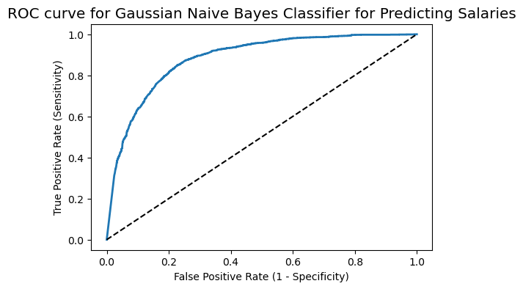
ROC CURVE
Gaussian Naive Bayes has the Area Under Curve with a value of 0.88.

